Slide 1

Safe Beginnings
Water Safety

Slide 2



Safe Beginnings is brought to you by:
Innovative Partnerships Program: Sierra-Sacramento Region
  A 14-County Collaborative of Child Abuse Prevention Councils
In Partnership with:
The Office of Child Abuse Prevention
The Child Abuse Prevention Council of Sacramento
Funded, in part, by California Department of Public Health Kids’ Plates Program
Notes:
The Sierra-Sacramento Region Innovative Partnerships Program is a 14-county collaborative of Child Abuse Prevention Councils (CAPCs). The collaborative is composed of CAPCs from Alpine, Amador, Calaveras, El Dorado, Inyo, Mono, Nevada (East), Nevada (West), Placer (West/South), Placer (North), Sierra, Sutter, Tuolumne, Yolo, and Yuba Counties. The Sierra-Sacramento Region Innovative Partnerships Program joins the California Department of Social Services/Office of Child Abuse Prevention in our mutual goals of strengthening the capacity of prevention networks to build resiliency in families and implement prevention practices to reduce child abuse and neglect.

Slide 3
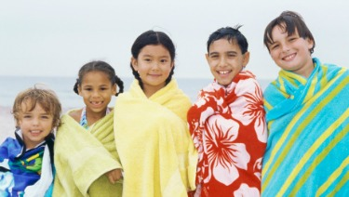
Purpose:
How to keep your child safe around water
We are going to talk about:
Child Water-Related Injuries
Water Safety in the Home
Water Safety in and around Pools
Water Safety in and near Open Water
Things to Remember
Notes:
Image: https://www.healthychildren.org/English/safety-prevention/at-play/Pages/Summer-Safety-Tips-Sun-and-Water-Safety.aspx
The purpose of this training is to provide information, tools, and resources to parents and caregivers of children age 0 to 5 that maximize safety and prevent unintentional injuries. By the end of this training, the participant will be informed as to how to prevent unintentional water-related injuries in the home, around pools, and near open water.

Slide 4
Child Water-Related Injuries
General
In the Home
Pools
County

Slide 5
Child Water-Related Injuries
General
3,536 unintentional drownings between 2005-2014
About 1 in 5 people who die from drowning are ages 0-14
Children ages 1-4 have the highest drowning rates
Around 80% of people who die from drowning are male
The fatal unintentional drowning rate for African Americans has historically been significantly higher
https://www.cdc.gov/homeandrecreationalsafety/water-safety/waterinjuries-factsheet.html
Notes:
Information taken from: https://www.cdc.gov/homeandrecreationalsafety/water-safety/waterinjuries-factsheet.html

Slide 6
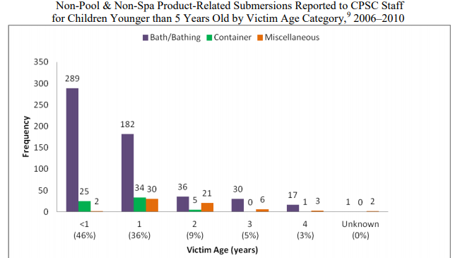
asds
Child Water-Related Injuries
In the Home
Between 2006-2010, there were:
434 fatalities
233 injuries
17 no apparent injury/unknown
for a total of 684 non-pool & non-spa product-related submersions for children younger than 5
https://www.cpsc.gov/s3fs-public/pdfs/nonpoolsub2012.pdf
Notes:
Image of Non-Pool & Non-Spa Product-Related Submersions Reported to CPSC Staff for Children Younger than 5 Years Old by Victim Age Category, 2006-2010: https://www.cpsc.gov/s3fs-public/pdfs/nonpoolsub2012.pdf
Severity
434 (63 percent) were fatalities
233 (34 percent) were injuries
17 (2 percent) were incidents with no apparent injury or unknown injury
Majority of the victims were younger than 2 years old (562 incidents, 82 percent)
Gender patterns observed were more males (367 incidents, 54 percent) than females (308 incidents, 45 percent)
Majority of the incidents occurred at a residence (632 incidents, 92 percent)

Slide 7
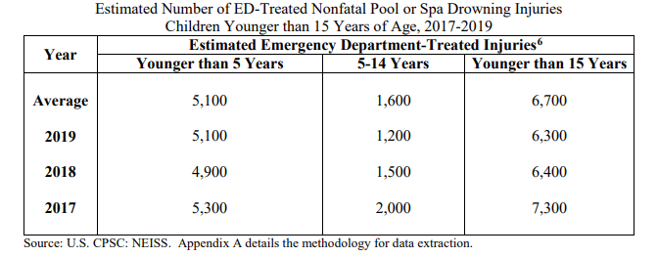
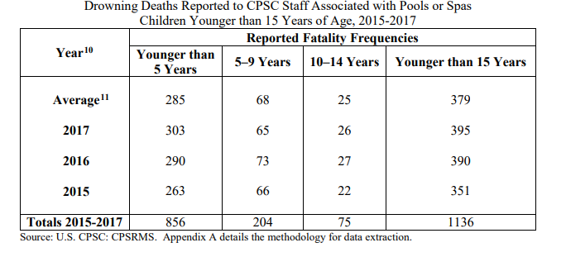
Child Water-Related Injuries
Pools
https://www.cpsc.gov/s3fs-public/2020-Submersion-Report-4-29-20_0.pdf?ghYmKOmkLBzmXo6Rjm96Qkn16JCpM1ir
Notes:
Image of Estimated Number of ED-Treated Nonfatal Pool or Spa Drowning Injuries Children Younger than 15 Years of Age, 2017-2019: https://www.cpsc.gov/s3fs-public/2020-Submersion-Report-4-29-20_0.pdf?ghYmKOmkLBzmXo6Rjm96Qkn16JCpM1ir
Image of Drowning Deaths Reported to CPSC Staff Associated with Pools or Spas Children Younger than 15 Years of Age, 2015-2017: https://www.cpsc.gov/s3fs-public/2020-Submersion-Report-4-29-20_0.pdf?ghYmKOmkLBzmXo6Rjm96Qkn16JCpM1ir

Slide 8
Child Water-Related Injuries in [Your County]
Include any county-specific data here.
To find statistics for your county, try looking at your county’s website. There may be more information on your county’s Public Health/Health Care website
Add your sources here:
Notes:
Information taken from:
Notes on County Statistics:

Slide 9
Water Safety in the Home
Information
Injury Prevention

Slide 10

Water Safety in the Home:
Information
Notes:
Image of Protecting Children in Your Home fact sheet: https://safekids.org/infographic/protecting-children-your-home
Information taken from:
https://www.preventchildinjury.org/toolkits/swimmingpoolsafety
https://safekids.org/watersafety
https://www.nationwidechildrens.org/research/areas-of-research/center-for-injury-research-and-policy/injury-topics/sports-recreation/drowning-prevention
Water Safety: In the Home
Children less than 1 year old are most likely to drown in a bath
Babies can drown in as little as 1 inch of water
Most drowning inside the home happen in the bathroom
Drowning can happen in as little as 20-60 seconds

Slide 11
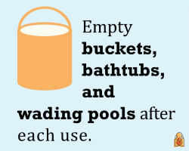

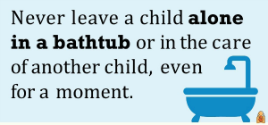
Water Safety in the Home:
Injury Prevention
https://www.preventchildinjury.org/toolkits/swimmingpoolsafety
http://www.homesafetycouncil.org/SafetyGuide/sg_water_w003.asp
Notes:
Image of water safety in the home tips (buckets, bathtubs, and wading pools): https://www.healthychildren.org/English/safety-prevention/at-play/Pages/Infant-Water-Safety.aspx
Image of water safety in the home tips (bathtubs): https://www.healthychildren.org/English/safety-prevention/at-play/Pages/Infant-Water-Safety.aspx
Image of water safety in the home tips (toilets): https://www.healthychildren.org/English/safety-prevention/at-play/Pages/Infant-Water-Safety.aspx
Information taken from:
https://www.preventchildinjury.org/toolkits/swimmingpoolsafety
http://www.homesafetycouncil.org/SafetyGuide/sg_water_w003.asp
Water Safety: In the Home
Install locks on toilet seats, bathroom doors, and laundry room doors
Empty all buckets of liquid, wading pools, etc.
Keep out of children’s reach
Flip kiddie pools so that they don’t fill with water
Always stay close enough to touch your child when they are in or near a tub, toilet, or bucket
Drain tub immediately after bath is over
Do not leave children alone in a tub with older children
Make sure water is cool enough to avoid burns
Keep all electrical items away from tubs and sinks and out of reach of children

Slide 12
Water Safety In and Near Pools
Information
Injury Prevention

Slide 13
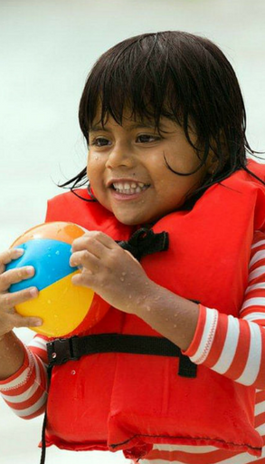
Water Safety In and Near Pools:
Information
Drowning is silent
Most at risk: Children ages 1-5
Boys are more likely to drown in pools than girls
On average, 363 children drown in pools and spas each year
Drownings are 100% preventable!
https://www.preventchildinjury.org/toolkits/swimmingpoolsafety
https://www.poolsafely.gov/
Notes:
Image of child wearing life vest and holding beach ball: https://www.poolsafely.gov/
Information taken from:
https://www.preventchildinjury.org/toolkits/swimmingpoolsafety
https://www.poolsafely.gov/
Water Safety: Pools
“Nearly 60% of children under 6 years old who drowned in a pool were not supposed to be in or near the water.” - https://www.preventchildinjury.org/toolkits/swimmingpoolsafety
Nearly 300 children younger than 5 drown in swimming pools each year
There are no splashing or warning sounds associated with a drowning incident
Signs of distress: head tilted back
Children under the age of 5 are at a higher risk of drowning in a pool
Drowning is the leading cause of death for toddlers 1-4 years old
Boys are two times more likely to drown in a pool than girls
2/3 of fatal drownings occur in May and August for most age groups
In 2016, the majority (74%) of reported fatal drowning victims younger than 15 were younger than 5
For 2016 through 2018, an estimated average of 6,600 children younger than 15 years old were reported as being treated in hospital emergency rooms for non-fatal drowning injuries in pools or spas.
73% were younger than 5 years old

Slide 14
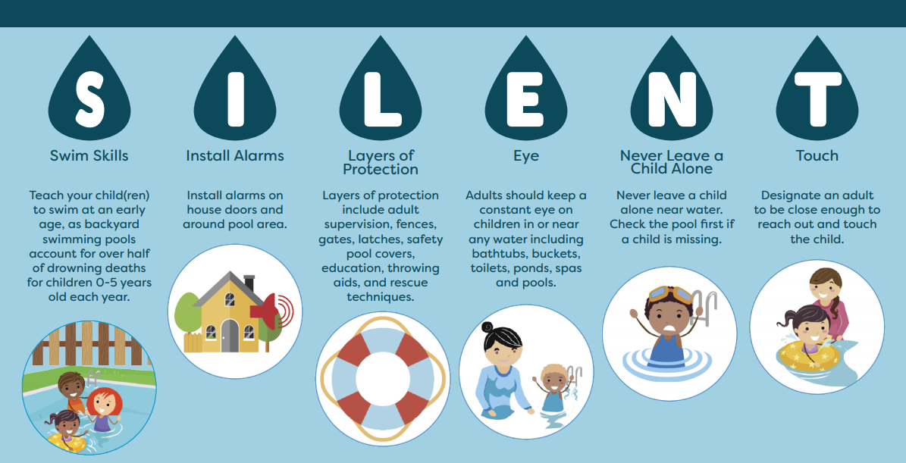
Water Safety In and Near Pools:
Injury Prevention
https://www.preventchildinjury.org/toolkits/swimmingpoolsafety | https://safekids.org/watersafety
Notes:
Image of SILENT water safety graphic: https://www.dds.ca.gov/wp-content/uploads/2019/05/Drowning_Prevention_Infographic_English.pdf
Information taken from:
https://www.preventchildinjury.org/toolkits/swimmingpoolsafety
https://safekids.org/watersafety
Water Safety: Pools
Always actively supervise children around pool settings (home, community, etc.)
Put away phones and other distractions
Designate a Water Watcher – switch designee every 15 minutes
Teach your child how to swim early on
Talk to your pediatrician about whether your child is developmentally ready
Learn how to swim yourself!
Remember that swim lessons do not make a child “drown proof”
Anyone who is not a good swimmer should wear a U.S. Coast Guard-approved life jacket
Cost: Many towns/cities have scholarships that help cover the cost of swimming lessons offered at public schools
Install self-closing, self-latching fences are installed around pools
If your child is visiting a home that has a pool, make sure that there is a functional fence around it (share safety instructions!)
An effective barrier prevents children from going over, under, or through
Never prop the fence open or leave furniture that can be used to climb nearby
Keep children away from drains and install proper drain covers
Hair, limbs, and jewelry/loose clothing can all get caught in drains
Stay away from pools that have loose, broken, or missing drain covers
Teach young children that “swim time is family time”– they are only allowed in a pool if an adult is with them
Stay within an arm’s reach of a child in a pool
Install pool and gate alarms
Install a pool/spa safety cover
Remove completely before anyone enters pool/spa
Remove/restrict access to ladders
Flip kiddie pools so that they do not fill with rainwater
Have a charged phone nearby at all times
If a child is missing, check the pool first
Learn CPR in case of an emergency
Keep pool chemicals locked safely away
Keep pool area clear of anything that can be tripped over
Stay out of pool during severe weather or thunderstorms

Slide 15
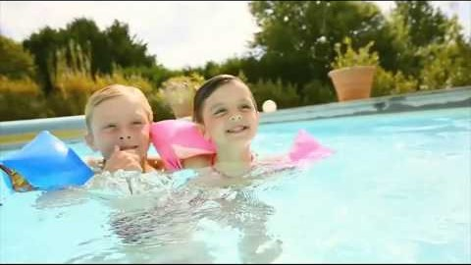
Water Safety in and near Pools
Pool and swimming safety tips for families
Notes:
Video of Pool and Swim Safety Tips for Families: https://www.youtube.com/watch?feature=emb_logo&v=TuyJK9NZ1Ro
Length: 1 min, 33 sec
Alternate videos available at:
https://www.preventchildinjury.org/toolkits/swimmingpoolsafety

Slide 16
Water Safety In and Near Open Water
Information
Injury Prevention

Slide 17
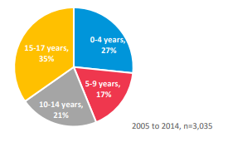
Water Safety In and Near Open Water:
Information
Includes any natural body of water (lakes, rivers, ponds, etc.)
Most at risk: Children ages 5-17
Swimming in open water is unlike swimming in a pool
Infants and young children are at risk of hypothermia
Open Water Deaths by Child’s Age
https://safekids.org/watersafety
https://safekids.org/safetytips/field_risks/boating
https://www.preventchildinjury.org/toolkits/swimmingpoolsafety
Notes:
Image of Open Water Deaths by Child’s Age pie chart: https://www.safekids.org/sites/default/files/dangerous_waters_research_report.pdf
Information taken from:
https://www.preventchildinjury.org/toolkits/swimmingpoolsafety
https://safekids.org/watersafety
https://safekids.org/safetytips/field_risks/boating
Water Safety: Open Water
Children 5-17 are most likely to drown in open water
Types of open water: Lakes, ponds, rivers, oceans, reservoirs, quarries
Swimming in open water is not the same as swimming in a pool
Hidden hazards: Dangerous currents (including rip currents), sudden drop-offs, limited visibility, depth of water, rocks and vegetation, cold temperatures, difficult-to-judge distances
Infants and young kids are at higher risk for hypothermia
Open water fatalities by age:
0-4: 23%
5-9: 13%
10-14: 15%
15-19: 49%

Slide 18
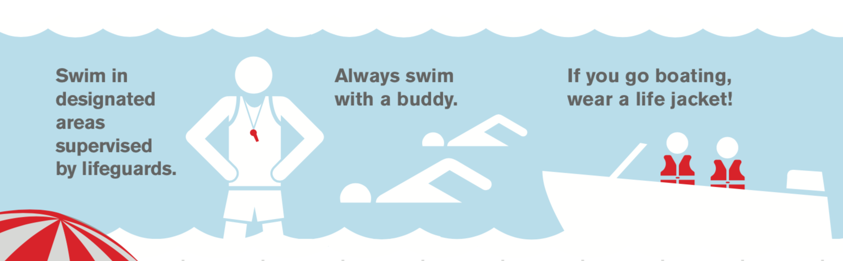
Water Safety In and Near Open Water: Prevention
Wear life jackets when necessary
Remain aware of water at all times
Pay attention to the weather
Avoid drinking alcohol
No diving in open water!
Keep young children warm
https://www.preventchildinjury.org/toolkits/swimmingpoolsafety | https://www.healthychildren.org/English/safety-prevention/at-play/Pages/Summer-Safety-Tips-Sun-and-Water-Safety.aspx
Notes:
Image of open water safety tips graphic: https://www.redcross.org/get-help/how-to-prepare-for-emergencies/types-of-emergencies/water-safety.html
Information taken from:
https://www.preventchildinjury.org/toolkits/swimmingpoolsafety
https://www.healthychildren.org/English/safety-prevention/at-play/Pages/Summer-Safety-Tips-Sun-and-Water-Safety.aspx
Water Safety: Open Water
Be aware of if you live near open water such as lakes, ponds, rivers, canals, etc. and remain alert
Always swim in a lifeguarded area
Children, inexperienced swimmers, and all boaters should wear U.S. Coast Guard-approved life jackets
Water wings and noodles are not a substitution for a proper life jacket
Avoid drinking alcoholic beverages while boating
Take extra precautions to keep infants and young kids warm
Make sure kids swim only in areas designated for swimming
Teach children not to dive into open water
Get out and away from water in the case of a storm

Slide 19
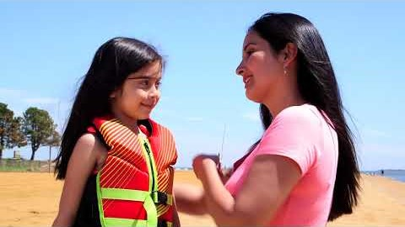
Water Safety: Open Water
Safety in Seconds: Open Water Safety
Notes:
Video of Water Safety: Open Water: https://www.youtube.com/watch?v=iMTyT7y6weU&feature=youtu.be
Length: 41 sec

Slide 20
What to do if someone is drowning
Yell for help
Perform lifesaving techniques while waiting for help
Call 911
https://www.bbc.co.uk/programmes/articles/1L2dJ3KQsjJPXdZ4Vp3jckh/what-to-do-if-someone-is-drowning
Notes:
Information taken from: https://www.bbc.co.uk/programmes/articles/1L2dJ3KQsjJPXdZ4Vp3jckh/what-to-do-if-someone-is-drowning
What to do if someone is drowning:
Get them out of the water, if possible
Yell for help if you are on your own
Have someone else call 911 if possible
Perform lifesaving techniques, in the following order:
Try to wake the person. Shake them, or even pinch their earlobe if you need to!
Lie them on their back and tilt their head and chin backwards. This will help to clear their airway.
Check for breathing. Look to see if their chest is rising and falling. Feel for their breath on your cheek. Listen for breathing sounds.
If no sign of breath, give the person 5 rescue breaths.
Perform CPR.
If you are on your own, now is the time to call 911.
While waiting for emergency services, continue 30 chest compressions followed by 2 rescue breaths.
If the person begins breathing before emergency services arrives, roll them onto their side with their leg and arm bent and their head tilted slightly back.

Slide 21
Summary
Always supervise young children
1
Post emergency phone numbers
2
Learn CPR in case of emergency
3
Model good habits for children
4
Utilize life jackets when needed
5

Slide 22
Water Safety:
Local Resources & Contact Information
Community resources near you:
[Include county-specific and local resources here]
Thank you!

Slide 23
Water Safety: Additional Information
Children’s Safety Network
Prevent Child Injury
Home Safety Council
Safe Kids Worldwide
Healthy Children
American Academy of Pediatrics
CDC-Home and Recreational Safety
Pool Safely
CPSC
Mayo Clinic
Red Cross
National Drowning Prevention Alliance
National Safety Council
California Department of Developmental Services
Nationwide Children’s Hospital
The World’s Largest Swim Lesson
Levi’s Legacy
Notes:
Children’s Safety Network
https://www.childrenssafetynetwork.org/injury-topics/drowning-prevention
Prevent Child Injury
https://www.preventchildinjury.org/toolkits/swimmingpoolsafety
Home Safety Council
http://www.homesafetycouncil.org/SafetyGuide/sg_water_w002.asp
Safe Kids Worldwide
https://safekids.org/watersafety
https://safekids.org/safetytips/field_risks/swimming-and-water
https://safekids.org/safetytips/field_risks/boating
Healthy Children
https://www.healthychildren.org/English/safety-prevention/at-play/Pages/5-Water-Safety-Tips-for-Kids-of-all-Ages.aspx
https://www.healthychildren.org/English/safety-prevention/at-play/Pages/Water-Safety-And-Young-Children.aspx
https://www.healthychildren.org/English/safety-prevention/at-play/Pages/swim-lessons.aspx
https://www.healthychildren.org/English/safety-prevention/at-play/Pages/Infant-Water-Safety.aspx
https://www.healthychildren.org/English/safety-prevention/at-play/Pages/Pool-Dangers-Drowning-Prevention-When-Not-Swimming-Time.aspx
https://www.healthychildren.org/English/safety-prevention/at-play/Pages/Life-Jackets-and-Life-Preservers.aspx
https://www.healthychildren.org/English/safety-prevention/at-play/Pages/Summer-Safety-Tips-Sun-and-Water-Safety.aspx
American Academy of Pediatrics
https://www.aap.org/en-us/about-the-aap/aap-press-room/campaigns/drowning-prevention/Pages/default.aspx
CDC-Home and Recreational Safety
https://www.cdc.gov/homeandrecreationalsafety/water-safety/waterinjuries-factsheet.html
https://www.cdc.gov/homeandrecreationalsafety/water-safety/index.html
https://www.cdc.gov/safechild/drowning/index.html
Pool Safely
https://www.poolsafely.gov/
CPSC
https://www.cpsc.gov/Research--Statistics/Injury-Statistics
Mayo Clinic
https://www.mayoclinic.org/healthy-lifestyle/infant-and-toddler-health/in-depth/child-safety/art-20044744
Red Cross
https://www.redcross.org/get-help/how-to-prepare-for-emergencies/types-of-emergencies/water-safety/drowning-prevention-and-facts.html
National Drowning Prevention Alliance (NDPA)
https://ndpa.org/
National Safety Council (NSC)
https://www.nsc.org/home-safety/tools-resources/seasonal-safety/drowning
California Department of Developmental Services
https://www.dds.ca.gov/initiatives/drowning-prevention/
Nationwide Children’s Hospital
https://www.nationwidechildrens.org/research/areas-of-research/center-for-injury-research-and-policy/injury-topics/sports-recreation/drowning-prevention
The World’s Largest Swim Lesson
https://www.wlsl.org/WLSL/For_Parents/Water_Safety_Tips/WLSL/Water_Safety.aspx?hkey=eff68728-2c9b-4112-a48f-84d23256e49c
https://www.wlsl.org/WLSL/The_Event/Drowning_Data/WLSL/Drowning_Data.aspx?hkey=7f1070a1-83e1-4c58-857d-ea086b4ae231
Levi’s Legacy
https://www.levislegacy.com/

Slide 24
Photo Attributions & Additional Information
Image of 5 children wrapped in beach towels:
https://www.healthychildren.org/English/safety-prevention/at-play/Pages/Summer-Safety-Tips-Sun-and-Water-Safety.aspx
Image of Non-Pool & Non-Spa Product-Related Submersions Reported to CPSC Staff for Children Younger than 5 Years Old by Victim Age Category, 2006-2010:
https://www.cpsc.gov/s3fs-public/pdfs/nonpoolsub2012.pdf
Image of Estimated Number of ED-Treated Nonfatal Pool or Spa Drowning Injuries Children Younger than 15 Years of Age, 2017-2019:
https://www.cpsc.gov/s3fs-public/2020-Submersion-Report-4-29-20_0.pdf?ghYmKOmkLBzmXo6Rjm96Qkn16JCpM1ir
Image of Drowning Deaths Reported to CPSC Staff Associated with Pools or Spas Children Younger than 15 Years of Age, 2015-2017:
https://www.cpsc.gov/s3fs-public/2020-Submersion-Report-4-29-20_0.pdf?ghYmKOmkLBzmXo6Rjm96Qkn16JCpM1ir
Image of Protecting Children in Your Home fact sheet:
https://safekids.org/infographic/protecting-children-your-home
Image of water safety in the home tips (buckets, bathtubs, and wading pools):
https://www.healthychildren.org/English/safety-prevention/at-play/Pages/Infant-Water-Safety.aspx

Slide 25
Photo Attributions & Additional Information
Image of water safety in the home tips (bathtubs):
https://www.healthychildren.org/English/safety-prevention/at-play/Pages/Infant-Water-Safety.aspx
Image of water safety in the home tips (toilets):
https://www.healthychildren.org/English/safety-prevention/at-play/Pages/Infant-Water-Safety.aspx
Image of child wearing life vest and holding beach ball:
https://www.poolsafely.gov/
Image of SILENT water safety graphic:
https://www.dds.ca.gov/wp-content/uploads/2019/05/Drowning_Prevention_Infographic_English.pdf
Image of Open Water Deaths by Child’s Age pie chart:
https://www.safekids.org/sites/default/files/dangerous_waters_research_report.pdf
Image of open water safety tips graphic:
https://www.redcross.org/get-help/how-to-prepare-for-emergencies/types-of-emergencies/water-safety.html

